Slide 1
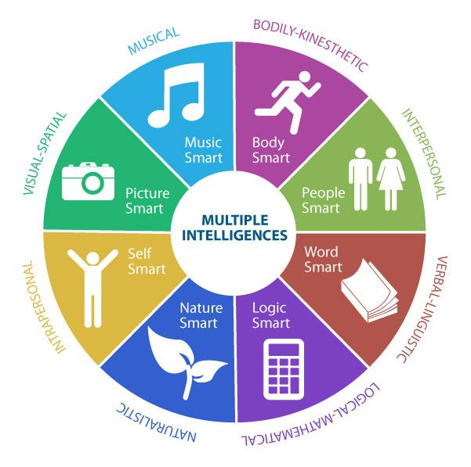
Humorous Mindset Ideas That Make a Difference!
Ms. June L. Blackwell, Med, nbct
Sanderson High School
Raleigh, NC 27609
https://honors-math-3-blackwell.weebly.com/

Slide 2
Humorous Mindset - Ideas That Make A Difference
The participants will interact and practice various mathematical activities that use the 8 Learning Styles of Howard Gardner - Visual, Mathematical, Verbal, Interpersonal, Intrapersonal, Natural, Bodily Kinesthetic, and Musical. I plan to share songs, cell phone activities, project ideas, and review strategies, to increase the Math 1, 2, and 3 "Mindset"!

Slide 3
Definition
Mathematical Mindsets provide practical strategies and activities to help teachers and parents show all children, even those who are convinced that they are bad at math, that they can enjoy and succeed in math. ...
Mathematical Mindsets: Explain how the brain processes mathematical learning.

Slide 4
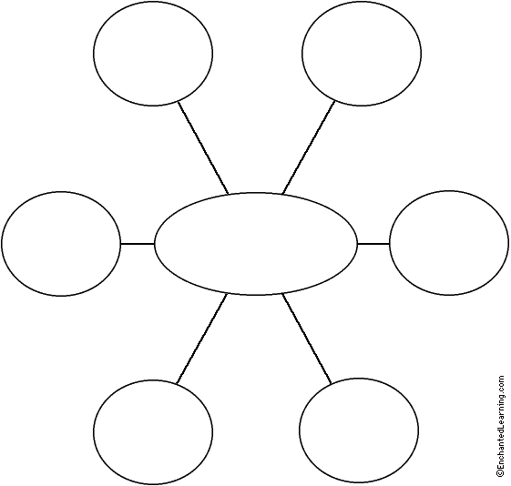
Graphic Organizer - Mindset “Tips”

Slide 5
Learning Styles of Howard Gardner 1. Visual (Bio - glyph)
Math 1
Slope – Lego/Connecting Blocks
Math 2
Parallel Map /Super Hero Transformations
Math 3
Brochure Project
Piece - wise Functions
Song
Barney & Types of Lines

Slide 6
TIP #2: ASK QUESTIONS THAT PROMOTE A CHALLENGE
Select problems or questions that have multiple solution paths and/or multiple solutions.
Open-Routed Problem – There are different paths to solve the problem, but only one solution. (i.e. Alicia’s bedroom is 20 feet long and 24 feet wide. What is the area?)
Open-Ended Problem – There are multiple solution paths and multiple solutions. (i.e. Alicia’s bedroom is 480 square feet. Record all the possible dimensions.)
Open-ended questions or problems are especially good for encouraging a growth mindset because the process becomes more important than the answer.

Slide 9
Song Time
Graphing Functions
(Math Convention)
Tune – “Allouette”
Graphing functions, joyfully graphing functions.
Graphing functions on my calculator.
Do you do a linear?
Yes I do a linear?
Stretch it up; flip it down.
You can shift it all around.
Chorus
Do you do a square?
Do you do a cube?
Do you do absolute value?
Do you do square roots?
Do you do greatest integer?
"Slope Intercept"
Modified – (Lyrics – 1994 FCTM Convention Tune - "Barney" or “This Old Man”)
We have mWe have bWe have slope – intercept family,With the slope interceptFormula today.We can graph lines any day.
Variations
By Debra Kinsey © 2005
Tune – “The Farmer in the Dell”
Y can vary directly,
Directly with or as x,
Y = k times x
And’s directly proportional to x.

Slide 10
Learning Styles of Howard Gardner 2. Verbal
Math 1
4 Representations
Siop Appoach
Picture, Word Problem, Table, & Graph
Math 2
Exponential vs. Linear - Venn Diagram
Math 3
½ Sheet - Word Problem - Theme

Slide 11
Song Time
Lines
Lyrics & Performance
by Vicki Young – Melody
“Old MacDonald Had a Farm”
There are four parts to every line, You must remember these. Points, slope, equation, graph, And keep them separate, please!
Chorus
Chorus – With one point here and one point there, Here a point, there a point, everywhere a point, point. Graphing lines is like child’s play, so let’s graph some today!
Oblique lines have x and y. The slope gives rise and run Just solve for y to start the graph, Use slope to make it fun!
Chorus
A vertical line, like x = 3, Has slope that’s UNDEFINED. Plot 3 on the x-axis and draw the graph, An UP and DOWN line.
Chorus
Y = 5 is a horizontal line. The slope is ZERO, you see. Plot 5 on the y-axis and draw the line, SIDE to SIDE it will be.
"Power Rule"
(Lyrics by Coulliette, King, & Rosas-Guyon Tune - "When You’re Happy”)
When you multiply like bases, add exponents.When you divide like bases, Subtract exponents.With a power to a power,With a power to a power,With a power to a power,Multiply exponents.When you have a negative exponent Change it’s place; Reciprocate!When you have zero exponent you get one.When you learn these rules,When you learn these rules,When you learn these rules,Then you can pass.

Slide 13
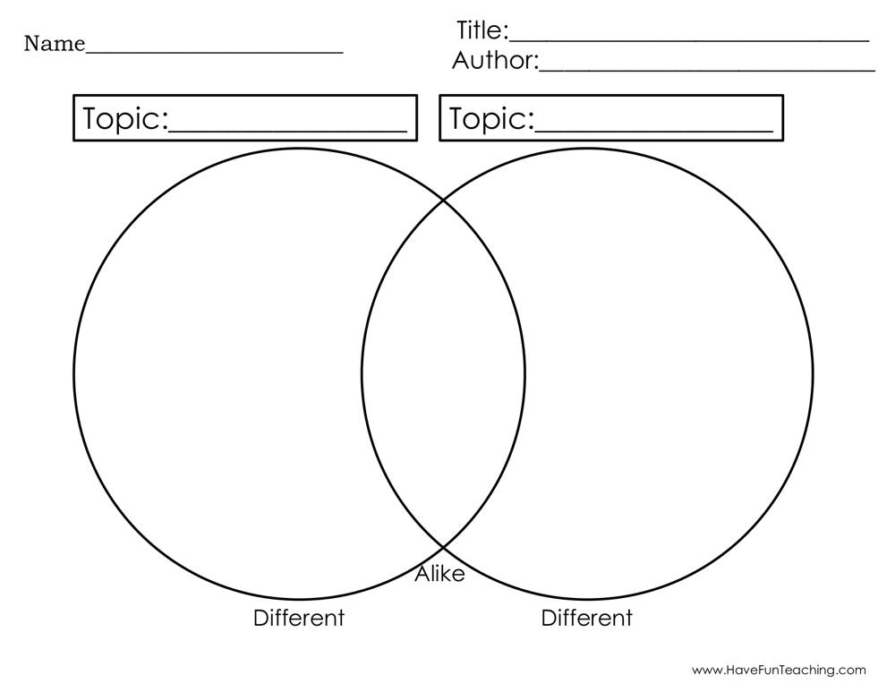

Slide 14
Learning Styles of Howard Gardner 3. Interpersonal
Math 1, Math 2, & Math 3
Hallway Card Review
Song
“e”

Slide 15
TIP #3: ALLOW FOR OPPORTUNITIES WHEN STUDENTS WORK TOGETHER
Giving your kids the time to work with others will build their problem-solving arsenal of strategies because they will be learning new ways to solve problems from each other.
I don’t know about you, but on more than one occasion one of my students was able to explain their problem solving strategy to another student better than I could.
You can also give team points for things such as effort and accountable talk, in addition to getting the correct answer.

Slide 16
Song Time
The Number We Call “e”
Tune – “The Lion Sleeps Tonight” by John A Carter – Chicago, IL
Chorus e-e-e-e- e-e-e-e-e- 2 point 7-1-8
2-7-1-8 (10 times)
There’s a number
A special number
We use it constant-leeee (2 times)
Chorus
For log-a-rithms
Yes log-a-rithms
The base is naturally-eeee (2 times)
Chorus
To com-pound int’rest
Contin-u-ous int’rest
It’s Pert shampoo for meeeeeee (2 times)
Chorus
(Two parts)
Part 1 – e-e-e-e-e-e-e-e-e-e,2 point 7-1-8
Part 2 – 2-7-1-8,…2-7-1-8,…2-7-1-8

