Slide 1

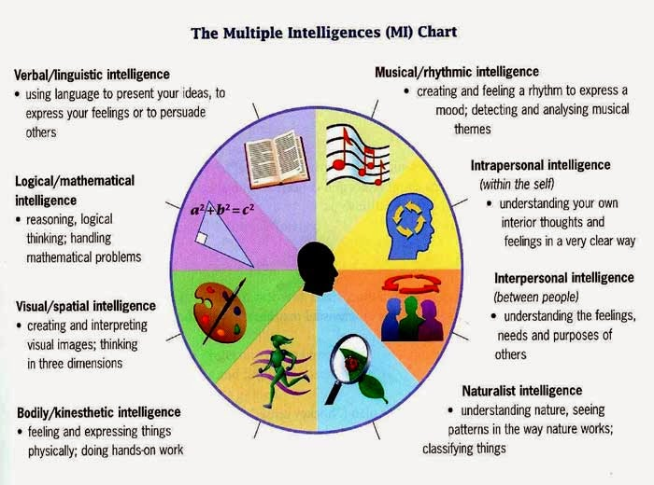
Learning Styles of Howard Gardner
4. Intrapersonal
Math 1, Math 2, & Math 3
Partner A & Partner B
Quizziz
  Solo
  Team
www.quizziz.com

Slide 2
Intrapersonal Activity
Partner A________________
Solve for x → 3x + 5 = 14
2. The sum or two numbers is 10 and the product is 24. Find the numbers.
3. Find the coordinate solution to:
3 = 2x - y
y = - x + 3
Partner B________________
Solve for x → 7x – 4 = 17
2. The difference of two numbers is 14 and the product is -24. Find the numbers.
3. Find the coordinate solution to:
y = 6x – 11
3x – y = 5

Slide 3
Quizziz
Classic - Solo
Team
Cell Phone Time!

Slide 4
TIP #5: TAKE TIME TO REFLECT (INCLUDING ERRORS)
Celebrate the process, even mistakes.
Celebrate mistakes?
YES! In fact, mistakes are valuable because we learn from them.
Example – “Thanks for sharing! I see where you were going with this. I think many other students may have the same misconception, so you are helping us. How could you have done this part differently?”

Slide 5
Learning Styles of Howard Gardner
5. Natural - (Leaf Activity)
Math 1
Pattern Blocks
  Recursive & Explicit
Math 2
Triangle Congruence
Math 3
Volume & Surface Area
Joy
Joy
Joy

Slide 6
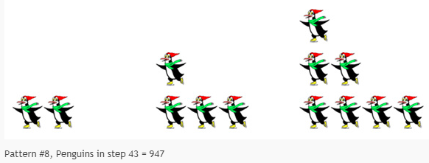
Pattern Blocks
Recursive
Explicit
Website Link
www.visualpatters.org

Slide 7
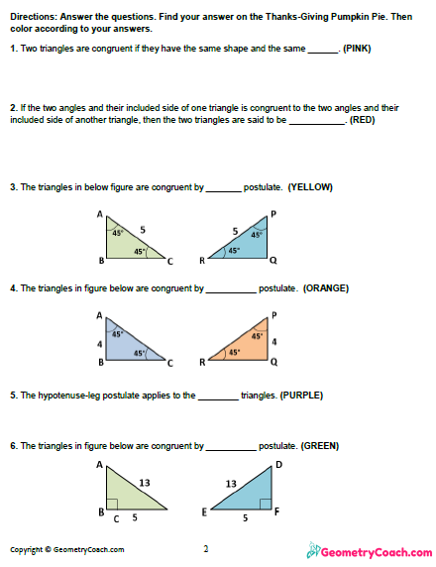
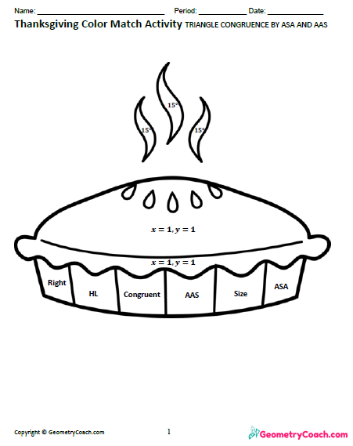
Triangle Congruence

Slide 8
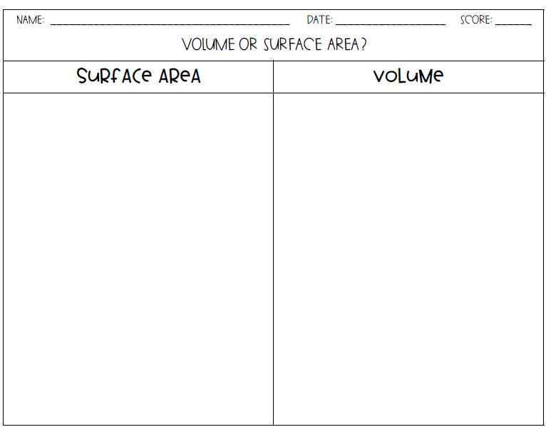
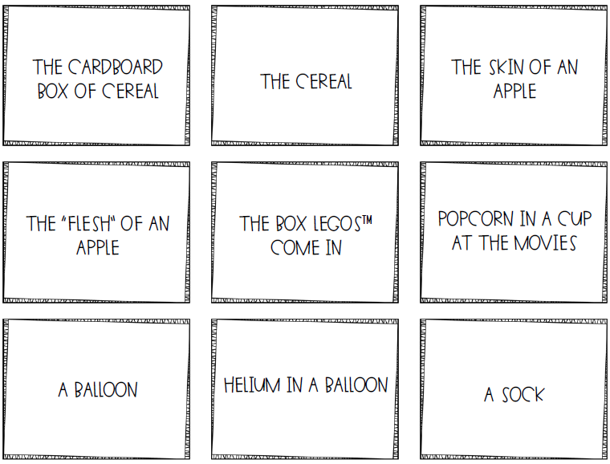
Volume & Surface Area

Slide 9
TIP #4: PROVIDE TIME FOR STUDENTS TO SHARE OUT HOW THEY SOLVED THE PROBLEM
After students work with a partner, spread the love!
Call on selected students to share out and justify their answers to entire class. The key for rich discussion is creating a safe environment where your kids will want to share, even if they are unsure of their answers.
Ask things like “What did you do to persevere through the problem?” “What was your plan of attack?” “What strategy did you use?”

Slide 10
Learning Styles of Howard Gardner
6. Bodily Kinesthetic
Math 1, Math 2, & Math 3
Relay Race
  With Notes
  Elimination Slips & “x’s”

Slide 11
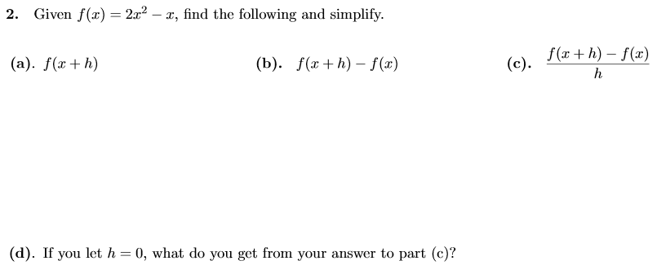
Relay Race

Slide 12
Relay Race w/Notes

Slide 13
Definition
Rules for Definite Integrals:
1. Order of Integration
b
b
_
=
a
a

Slide 14
Definition
Rules for Definite Integrals:
4. Sum and Difference

Slide 15
Try This
If
Find
and
3

Slide 16
Definition
Rules for Definite Integrals:
5. Additivity

Slide 17
Try This
If
Find
and
31

Slide 18
Elimination Slips
Brown Snails
X X X X X
Pink Flamingo
X X X X X
.
.
X
X
Green Turtle
X X X X X
Purple Eggplant
X X X X X
X
.
.
X

Slide 19
