Slide 1
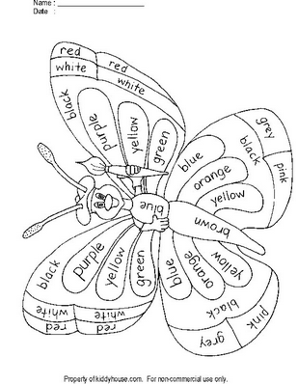
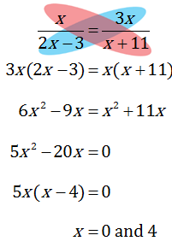
Butterfly Math
5x = 0 x – 4 = 0

Slide 2
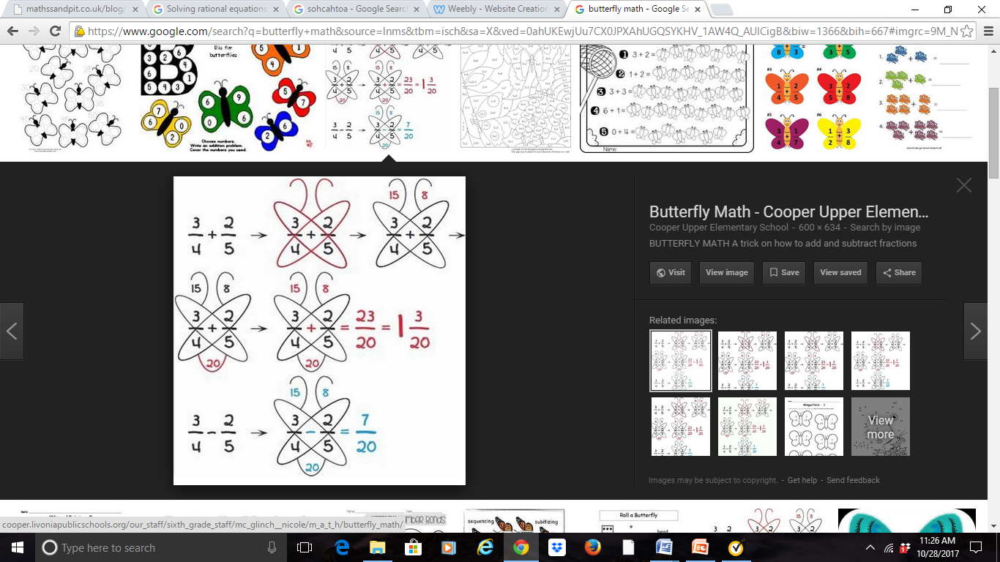
Songs
Cross – cross Fraction Chant
Cross cross,
Multiply the bottom,
Only when
It’s plus or minus

Slide 3
Songs
Cross – cross Fraction Chant
Cross cross,
Multiply the bottom,
Only when
It’s plus or minus
(x – 5) (x – 1) =0
x – 5 =0 x – 1 =0
x = 5 or x = 1

Slide 4
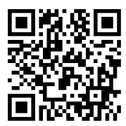
Graphic Organizers
Guided Notes
Class Notes or
Video Clip Notes
Transformation Graphic Organizer – Watch Video Clip and take notes
Definition | Real – Life Examples
Picture | Additional Information
Reflection

Slide 5


Song Time!
Oh my T I, graphing calculator,
helps me find the best – fit line.
If I know just, how the keystroke goes,
I’ll be out of this math bind.
First the stat plot, then the stat key,
let’s me edit all my lists.
Then I can check back, on the graph deck, and zoom 9 is in the midst.
Back to stat then, on to calc and,
my equation I won’t miss.
‘Cause I now choose, the right regression tool, and I won’t hear the teacher hiss.
To see the model, is so subtle,
so I simply follow suit.
To y =, then the vars coos,
and statistics gets the boot.
The E Q, and regression do,
and the graph will show up clear.
Now I’ve done it, and I’m such a hit,
so I’ll yell out a shout of cheer.
Best Fit Wit
By Debra Kinsey © 2006
Melody: "Oh My Darling Clementine"

Slide 6
TIP #1: USE THINK-ALOUDS TO MODEL HOW TO SOLVE PROBLEMS
Think-alouds are so important and are oftentimes overlooked. If we want our kids to develop a growth mindset we must model what that looks like.
Make a habit of showing your students how you would solve a problem and add in growth mindset principles of effort and perseverance.
Example – “Guys this problem looks really tough, but I am going to try my best. First I need to create a plan. Hmmm. I think I am going to draw a visual here. I’ll try an area model.”

Slide 7
Technological Suggestions
www.wheeldecide.com
www.polleverywhere.com
www.plickers.com
www.mathisfun.com
www.purplemath.com
www.superteacherworksheets.com
http://www.superteachertools.us/jeopardyx/
www.flipquiz.me
www.kahoot.com
https://quizizz.com
https://quizlet.com/
Blend Space aka Tes
www.mathwarehouse.com
Wheel Decide
Poll Everywhere
Plickers
Math is Fun
Purple Math
Super Teacher Worksheets
Super Teacher Jeopardy
FlipQuiz
Kahoot
Quizziz
Quizzlet (flashcards)
Tes
Math Warehouse

Slide 8
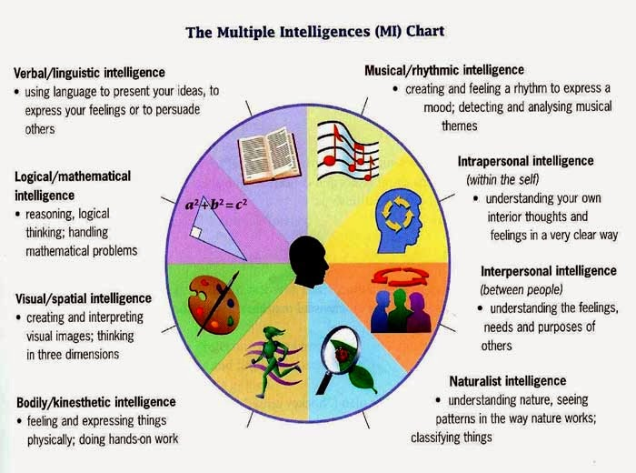
Learning Styles of Howard Gardner

Slide 9

The “5 Tips” of “Mindset” for the Classroom
Use Think-Alouds to Model How to Solve Problems
Ask Questions That Promote A Challenge
Allow For Opportunities When Students Work Together
4. Provide Time For Students To S
Share Out How They Solved The
Problem (Math Spy)
5. Take TIme To Reflect (Including
Errors)
https://mrelementarymath.com/growth-mindset-math/

Slide 10
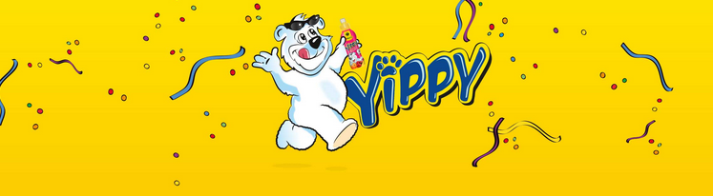
Follow the Directions Below:
If you learned something new, shout – “Yippy”.

Slide 11
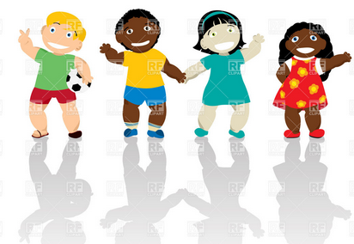
Follow the Directions Below:
If you plan on trying something that you have seen here today, “Wave your hands in the air”.

Slide 12
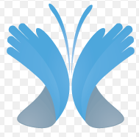
Follow the Directions Below:
If you have laughed, smiled, grinned, and/or giggled today, turn to someone near you and say “Ms. Blackwell is AWESOME” and clap your hands!

Slide 13
Reflection Time
What have you learned?
Is there anything that you have heard or seen today that you might use?
Do not be afraid to try something NEW!
(If it works, fine.
If it does not, look for a
“life lesson” and
move on.)

Slide 14


So Long Farewell, we have to go back home.
I hope you learned a thing or 2 that’s useful.
The time for us is slowly slipping by,
We’ve had some fun New friends that we have won.
Good bye, For now, Have Fun with Math.
It’s A Rap!
Does anyone notice anything “odd”?

Slide 15
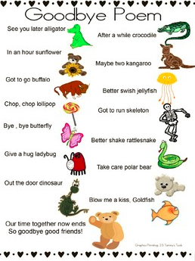
In Conclusion…
If you need the web address for today’s session, see the next slide.
If you are ready for your next session – Smile, get – up, and have a good day!

Slide 16
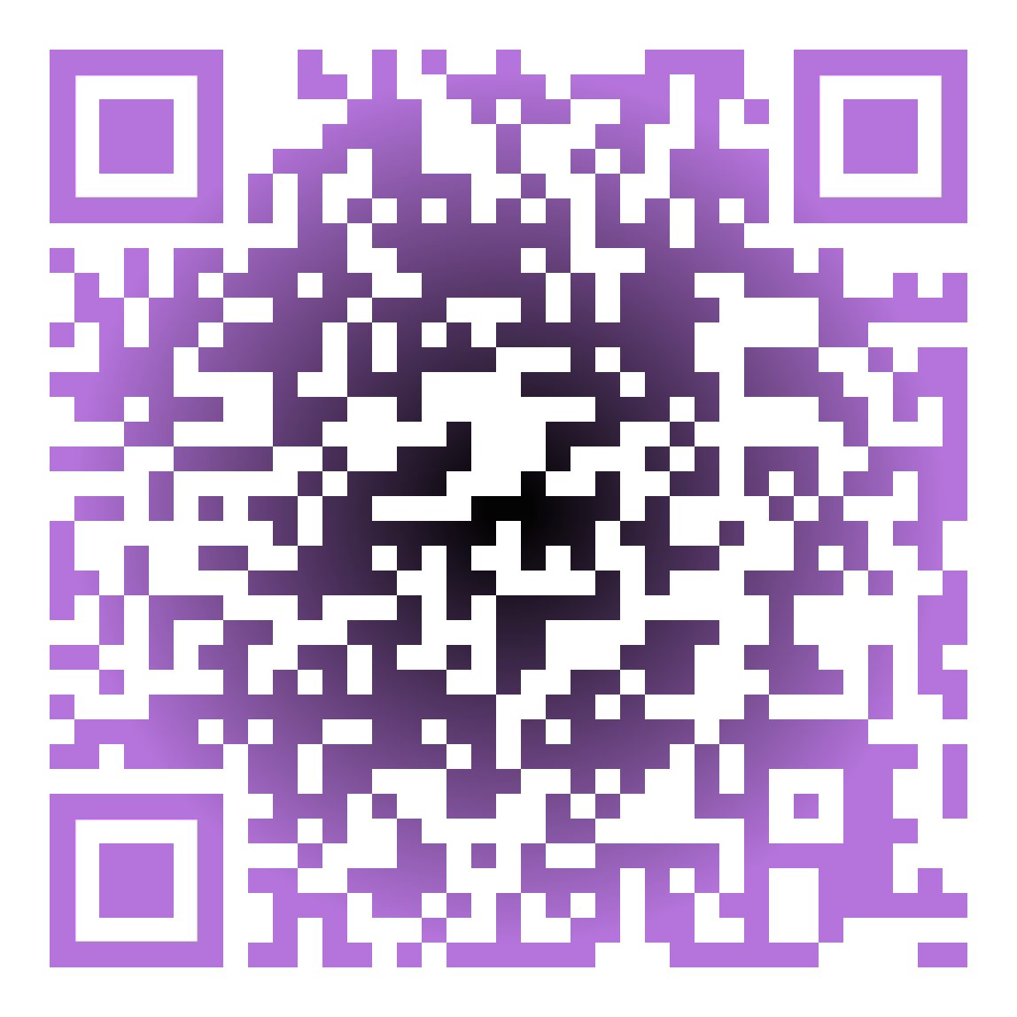
Thank You for Coming!
Good Luck with “MVP”!
This Workshop
My Website https://honors-math-3-blackwell.weebly.com/

